Slide 1
Lecture on
Minimum Spanning Tree
(Kruskal’s Algorithm)
Avinash Kumar Sharma
Assistant Professor, Department of CSE
ABES INSTITUTE OF TECHNLOGY, GHAZIABAD

Slide 2
Tree
A connected acyclic Graph is a tree.
Spanning tree of a connected graph G=(V,E): a sub graph T=(V,E’) of G, and T is a tree, i.e. T spans the whole of V of G.
W(T)= sum of the weights of all edges of T.
Minimum Spanning Tree ( MST): Spanning tree having minimum weight of a edge weighted connected graph.

Slide 3
Definition of MST
Let G=(V,E) be a connected, undirected graph.
For each edge (u,v) in E, we have a weight w(u,v) specifying the cost (length of edge) to connect u and v.
We wish to find a (acyclic) subset T of E that connects all of the vertices in V and whose total weight is minimized.
Since the total weight is minimized, the subset T must be acyclic (no circuit).
Thus, T is a tree. We call it a spanning tree.
The problem of determining the tree T is called the minimum-spanning-tree problem.

Slide 4
Problem: Laying Telephone Wire
Central office

Slide 5
Wiring: Naïve Approach
Central office
Expensive!

Slide 6
Wiring: Better Approach
Central office
Minimize the total length of wire connecting the customers

Slide 7
Real Life Application of a MST
A cable TV company is laying cable in a new neighborhood. If it is constrained to bury the cable only along certain paths, then there would be a graph representing which points are connected by those paths. Some of those paths might be more expensive, because they are longer, or require the cable to be buried deeper; these paths would be represented by edges with larger weights. A minimum spanning tree would be the network with the lowest total cost.

Slide 8
MST Applications
power outlet
or light
Electrical
wiring
of a house
using
minimum
amount of
wires
(cables)

Slide 9
MST Applications

Slide 10
Graph
Representation

Slide 11
Minimum
Spanning
Tree
for
electrical
eiring

Slide 12
Some Definition
Cut:
  Partition of V. Ex: (S, V-S)
Cross:
  Edge (u,v) crosses the cut (S, V-S) if one of its endpoints is in S and the other is in V-S.
Light edge:
  An edge crossing a cut if its weight is the minimum of any edge crossing the cut.

Slide 13
Kruskal's Algorithm
Edge based algorithm
Add the edges one at a time, in increasing weight order
The algorithm maintains A – a forest of trees. An edge is accepted it if connects vertices of distinct trees
We need a data structure that maintains a partition, i.e.,a collection of disjoint sets
  MakeSet(S,x)
  Union(S_{i},S_{j})
  FindSet(S, x)

Slide 14
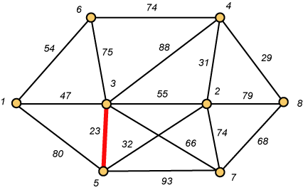
Kruskal – Step 1

Slide 15
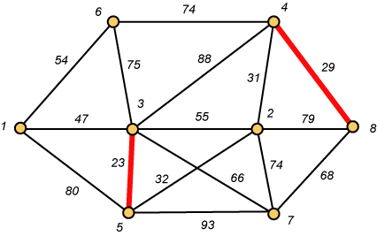
Kruskal – Step 2

Slide 16
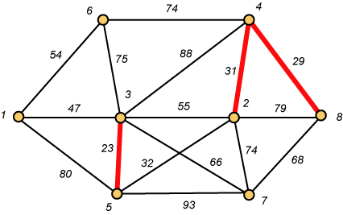
Kruskal – Step 3

Slide 17
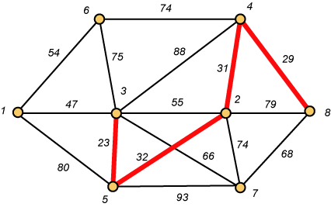
Kruskal – Step 4

Slide 18
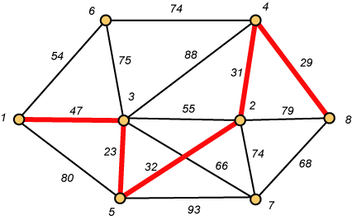
Kruskal – Step 5

Slide 19
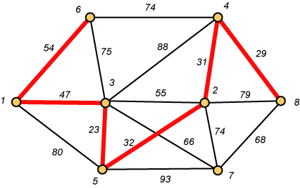
Kruskal – Step 6

Slide 20
Why Avoiding Cycles Matters
Up to this point, we have simply taken the edges in order of their weight. But now we will have to reject an edge since it forms a cycle when added to those already chosen.

Slide 21
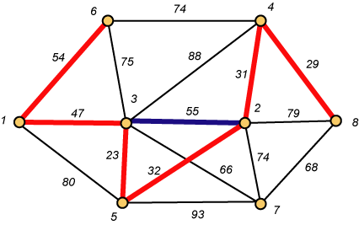
Forms a Cycle
So we cannot take the blue edge having weight 55.

Slide 22
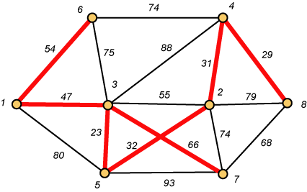
Kruskal – Step 7 DONE!!
Weight (T) = 23 + 29 + 31 + 32 + 47 + 54 + 66 = 282

Slide 23
Disjoint-Set
Keep a collection of sets S₁, S₂, .., S_{k},
  Each S_{i} is a set, e,g, S₁={v₁, v₂, v₈}.
Three operations
  Make-Set(x)-creates a new set whose only member is x.
  Union(x, y) –unites the sets that contain x and y, say, S_{x} and S_{y}, into a new set that is the union of the two sets.
  Find-Set(x)-returns a pointer to the representative of the set containing x.

Slide 24
Kruskal's Algorithm
The algorithm adds the cheapest edge that connects two trees of the forest
MST-Kruskal(G,w)
01 A ← ∅
02 for each vertex v ∈ V[G] do
03 Make-Set(v)
04 sort the edges of E by non-decreasing weight w
05 for each edge (u,v) ∈ E, in order by non-decreasing weight do
06 if Find-Set(u) ≠ Find-Set(v) then
07 A ← A ∪ {(u,v)}
08 Union(u,v)
09 return A
O(V)
O(ElogE)
O(E)
O(V)
Overall Complexity: O(VE)

Slide 25
Kruskal’s algorithm
9
b
a
2
6
E = {(a,d), (c,d), (d,e), (a,c),
(b,e), (c,e), (b,d), (a,b)}
d
5
4
4
5
5
e
c
Forest
{a}, {b}, {c}, {d}, {e}
{a,d}, {b}, {c}, {e}
{a,d,c}, {b}, {e}
{a,d,c,e}, {b}
{a,d,c,e,b}
A
∅
{(a,d)}
{(a,d), (c,d)}
{(a,d), (c,d), (d,e)}
{(a,d), (c,d), (d,e), (b,e)}

Slide 26
Thank You..!

